Slide 1
Sounds of Urgency: Investigating an Audio Dataset for Emergency Vehicle Sirens and Road Noises
Authors: Frances Cue, Jerry Gonzalez, Nick Johnson, and Chi So

Slide 2
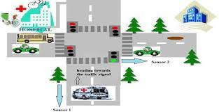
What are the potential applications and benefits of analyzing such a dataset?
Traffic congestion, accidents and pollution are a reality in today's society.
How do we solve the problem?
Improve current infrastructure (Costly and not always practical)
Use the latest technology such as AI to make better use of the current infrastructure.
Using AI techniques to distinguish emergency vehicles from traffic and road noise can improve traffic flow and reduce congestion.
Additionally, emergency response times can be improved for fire and health events.

Slide 3
Dataset
Our dataset was created specifically for the use case of identifying ambulance sounds vs. road noises.
Labeled as ambulance sound (932 rows) vs. road noise (901 rows)
Feature | Definition | High sounds | Low sounds
Chroma STFT | Represents the pitch content of a sound | Violin | Bass guitar
Spectral centroid | Represents the center of mass of the frequency spectrum of a sound. “Brightness” of a sound | Trumpet | Tuba
Spectral bandwidth | Represents the width of the frequency spectrum of a sound. It is the variance from the spectral centroid. | Violin | Bass Drum
Rolloff | Measure of how quickly the energy of the sound decreases as it moves into different frequencies. | Guitar strum | One hit on a drum
Zero Crossing Rate | When a signal changes from positive to negative and vice versa. | Human speech | White noise
Mel Frequency Cepstral Coefficient 1- 20 | MFCC is a compact representation of the spectrum of an audio signal. Each of the 20 coefficients extracted contains information about the rate change in each spectrum band. | Female voice | Male voice
Notes:
Our dataset was created specifically for the use case of identifying ambulance sounds vs. road noises by researchers from Ziauddin University, Karachi, Pakistan
It was collected through mixed methods such as audio from video surveillance, laptop audio recordings, and microphones at three different locations that were specifically selected close to hospitals to increase the chances of collecting ambulance sounds.
In addition, online audio road recordings were also added to the dataset for additional road noise data. It was manually labelled as ambulance sound vs road noise.
Features in the dataset are as follows
Chroma STFT - represent pitch content of a sound - Think of a high pitch instrument such as violin versus a bass guitar
The spectral centroid is represents the center of mass of the frequency spectrum of a sound. It is generally argued to contribute to the perceived “brightness” of a sound, given that sounds with higher centroids (such as trumpet) tend to be perceived as brighter than sounds with lower centroids (such as tuba).
Spectral bandwidth -
Represents the width of the frequency spectrum of a sound. It is the variance from the spectral centroid.
The violin has a high spectral bandwidth, meaning that it produces a wide range of frequencies while bass guitar has a low spectral bandwidth, producing a narrow range of frequencies.
Spectral rolloff - Measures how quickly the energy of the sound decreases as it moves from different few
Strumming a guitar may have a longer spectral rolloff as the sound bounces inside the body of the guitar while a rolloff on one hit on a drum’s sound will not linger after it’s been played.
Zero crossing rate (ZCR) is
When a signal changes from positive to negative and vice versa.
ZCR is a helpful feature in speech detection because it can be used to distinguish between speech and non-speech sounds. Speech sounds typically have a higher ZCR than non-speech sounds because the amplitude of speech signals is constantly changing,
While white noise sounds pretty monotone, and will typically have the same amplitude.
Mel Frequency Cepstral Coefficient is a compact representation of the spectrum of an audio signal. Each of the 20 coefficients extracted contains information about the rate change in each spectrum band.
MFCC 1: The first MFCC coefficient represents the overall energy or power of the audio signal. It tends to capture the global loudness or intensity information.
MFCC 2-20: These coefficients represent the distribution of spectral energy across different frequency bands. They provide more detailed information about the shape of the audio spectrum. When comparing male and female voices, you may observe differences in the MFCC coefficients related to the pitch range. MFCC 1 might be higher for female voices due to their higher fundamental frequencies, while the higher MFCC coefficients (e.g., MFCC 2-20) could exhibit varying patterns related to the vocal resonance characteristics of males and females.

Slide 4
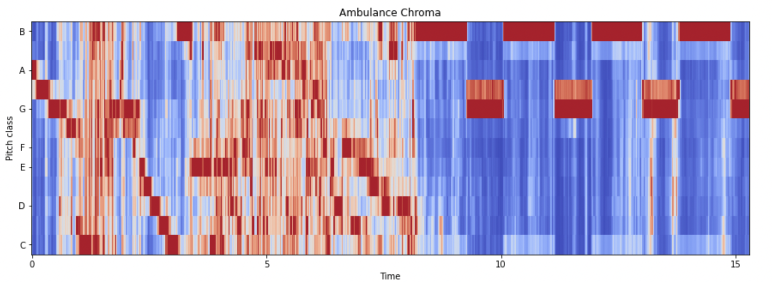

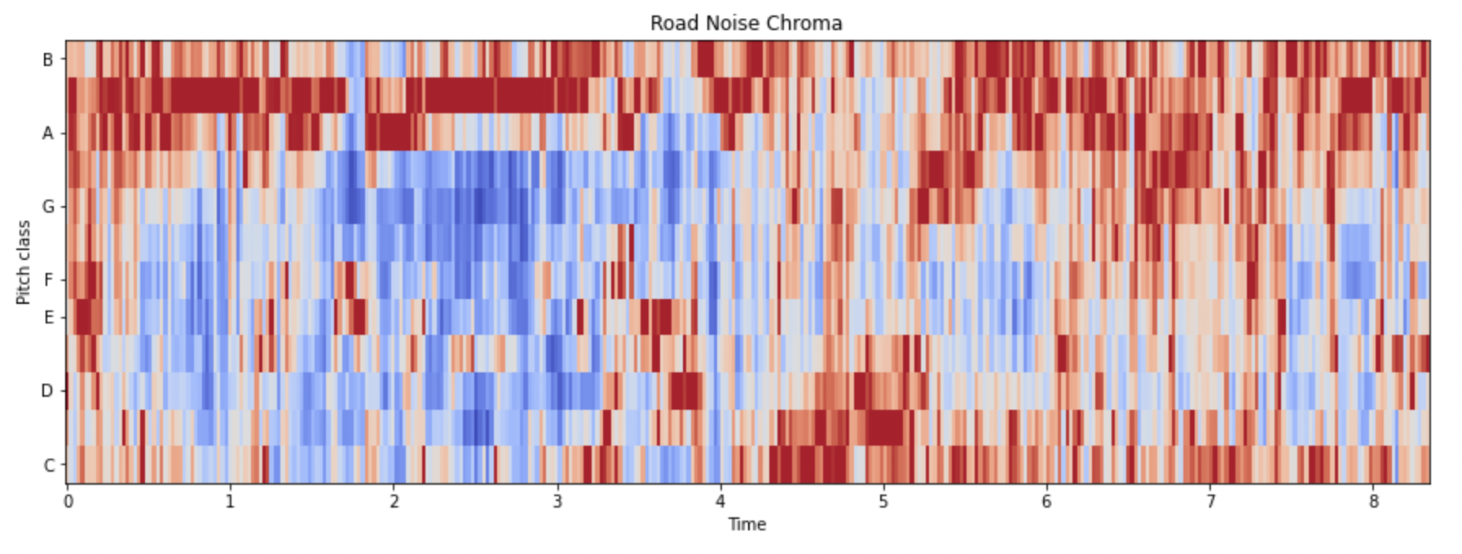
Notes:
Here we took 1 sample labeled road and one sample labeled ambulance. I will play the ambulance sound first then the road, and I want you to notice the difference in chroma, or the pitch contents of the signal. Observe that for the chroma of ambulance, the sound is initially all over all the place but then the siren dominates towards the ten second mark while the road noise has scattered pitches all throughout the length of the audio.
To talk about our baseline model, here’s Nick.

Slide 5

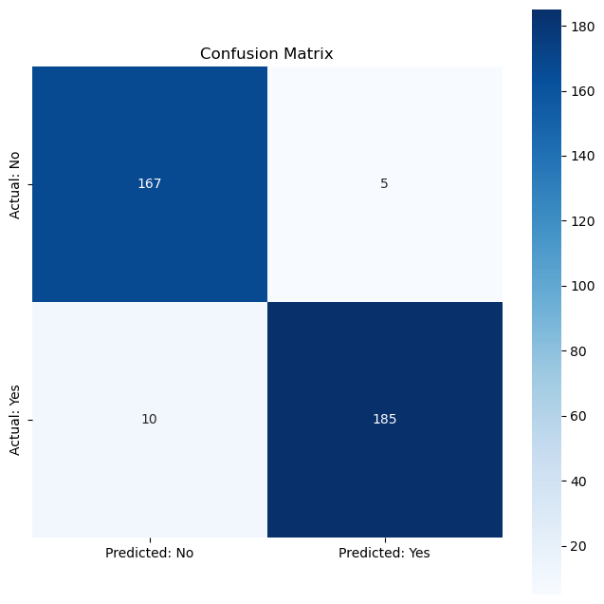
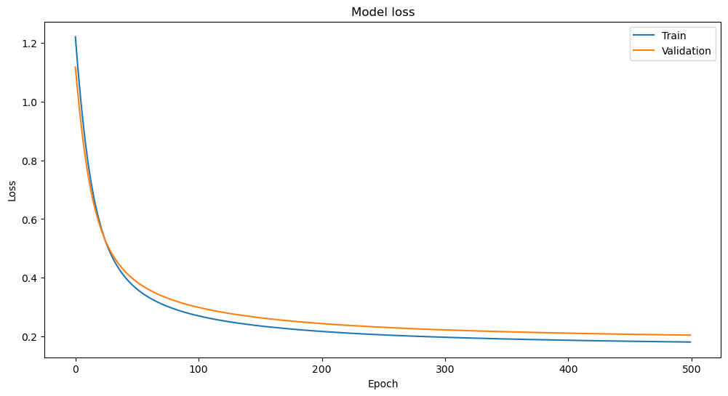
Baseline Model Logistic Regression
Notes:
We started by fitting a logistic regression model with an 80/20 train test split and 10% for validation. Initially we were getting around 65% accuracy, but after learning to standardize our variables, our model was able to converge. And you can see we have quite strong results coming in at 96% accuracy. Since this is a shallow network it’s not too computationally expensive, so we could afford to run it for 500 epochs to ensure minimal loss. In addition to accuracy, we evaluated recall, prevision, and F1 score, though because this is a binary classification task, it’s not surprising these metrics are similar.

Slide 6
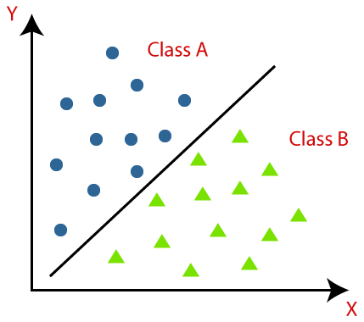
Future Models & Techniques
Reduce feature dimensionality for visualization
27 -> 2
K nearest neighbor - 52% accuracy so far
Improve feature selection
Feed Forward Neural Network
Convolutional Neural Network
Transform audio files into spectrogram images
Random Forest
Notes:
So the question is, where do we go from here. Firstly, given the success of our logistic regression model, it seems our data has a linear decision boundary. However, we are using 27 features so this is difficult to visualize. We’d like to apply the techniques discussed in this week's async to reduce our feature dimensionality and confirm this hypothesis. Then, it becomes an exercise to trying non-linear models to capture outliers. We’ve begun some work in this direction using KNN limited to x features but the accuracy has been much worse. We plan to add the same the full slate of 27 features, but ultimately it’s seeming like neural nets and decision trees are more promising. We plan to fit both a feed forward neural net and a convolutional neural network leveraging spectrogram images of our audio files. Random forest

Slide 7
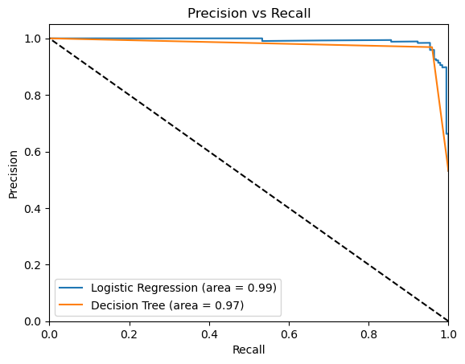
Result Evaluation
Loss Function
Log loss/ Binary Cross Entropy
Metrics
Precision
It’s a balanced data
High recall worsens regular traffic flow
Most traffic aren’t emergency vehicles
False negative won’t causes a negative impact compared to the current state
Precision/recall curve and AUC
Model comparison
Notes:
Log loss measures the dissimilarity between predicted probabilities and actual labels.
It is commonly used for binary classification tasks.
We can also use it for tracking the training history on training set
Moving on to metric, we will select precision as our metric for our training and testing dataset.
First, as we have shown, our data is pretty balanced, implying an equal representation of emergency vehicle and road noise.
This ensures the model is trained on an unbiased dataset.
Note that, high recall aims to minimize false negatives by capturing most emergency vehicles.
However, excessively high recall may impact regular traffic flow by triggering unnecessary responses.
Achieving a balance is crucial to maintain an efficient traffic system.
However, False negatives (missed emergency vehicles) do not have a significant negative impact when compared to the current state.
Further,
The precision/recall curve illustrates the trade-off between precision and recall at various classification thresholds.
The area under the curve (AUC) quantifies the model's overall performance, considering both precision and recall.
We can compare different models based on these values, especially with multiple model like CNN, KNN and FNN to give us a full picture.
That’s it for our presentation. Thanks all! Any questions ?

Slide 8
Thank You!
Questions?

Slide 9
References:
Daly, Heather, "The influences of musical training and spectral centroid on perceptual interactions of pitch and timbre" (2017). Masters Theses. 516. https://commons.lib.jmu.edu/master201019/516
https://devopedia.org/audio-feature-extraction#:~:text=The%20spectral%20bandwidth%20or%20spectral,correlation%20with%20the%20perceived%20timbre.

